Slide 1
One Dimensional Motion
The Special Case of Uniform Acceleration

Slide 2
The Last Lecture
During the last lecture, we discussed:
  Position
  Displacement
  Distance
  Average velocity
  Speed
  Instantaneous speed
  And a little bit of calculus
Today we will discuss the special case of uniform acceleration, and derive the “big five”…., yes by using a little calculus.

Slide 3

What does the position vs. time data look like for an elevator?
We can clearly see from the data that the position does not change for the first or last second.
However, what does its motion look like in between?
Time (s) | Position (m)
0 | 0
1 | 0
2 | 1
3 | 4
4 | 8
5 | 12
6 | 16
7 | 20
8 | 24
9 | 27.5
10 | 29.1
11 | 30
12 | 30
Deceleration
(decreasing speed)
decreasing slope
Constant Speed
Positive Acceleration
(increasing speed)
Δy
Δt
increasing slope
Slope = $\frac{\text{Δ}\text{y} }{\text{Δ}\text{t} }$ equals the speed

Slide 4
A Mathematical Description of Motion
How can the motion of the elevator be represented mathematically?
y = -0.65t² + 14.31t - 48.82
y = 4.00t - 8.00
With the exception of the first and last second of the dataset, the motion of the elevator can be broken up into three distinct segments:
  Positive acceleration from 1 – 3 s
  Constant speed from 3 – 8 s
  Negative acceleration from 8 – 11s
y = t² – 2.00t + 1.00

Slide 5
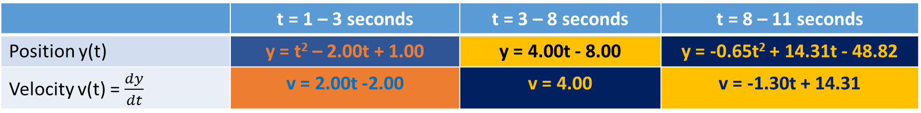

 | t = 1 – 3 seconds | t = 3 – 8 seconds | t = 8 – 11 seconds
Position y(t) | y = t² – 2.00t + 1.00 | y = 4.00t - 8.00 | y = -0.65t² + 14.31t - 48.82
Velocity v(t) = $\frac{dy}{dt}$ | v = 2.00t -2.00 | v = 4.00 | v = -1.30t + 14.31
Time (s) | Velocity (m/s)
0 | 0.00
1 | 0.00
2 | 2.00
3 | 4.00
4 | 4.00
5 | 4.00
6 | 4.00
7 | 4.00
8 | 4.00
9 | 2.61
10 | 1.31
11 | 0.01
12 | 0.00
Constant velocity
Slope = $\frac{\text{Δ}\text{v} }{\text{Δ}\text{t} }$ equals the acceleration
v = -1.30t + 14.31
v = 2.00t -2.00
Positive acceleration
Negative acceleration

Slide 6
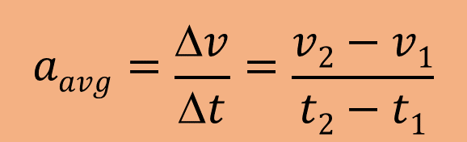

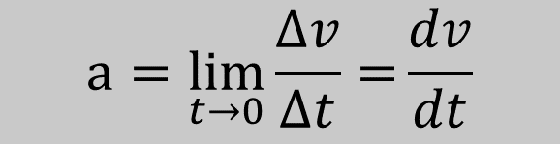
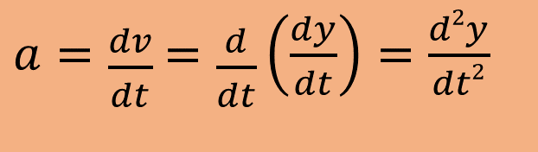
Finding Acceleration from the Equations for Position and Velocity
$$aavg=\frac{Δv}{Δt}=\frac{v2−v1}{t2−t1}$$
As the time interval approaches 0, the value for acceleration becomes the instantaneous acceleration.
$$a=\lim_{t→0}{\frac{∆v}{∆t}=}\frac{dv}{dt}$$
Since $v=\frac{dy}{dt}$,
$a=\frac{dv}{dt}$ $=\frac{d}{dt}\left(\frac{dy}{dt}\right)=\frac{d2y}{dt2}$

Slide 7
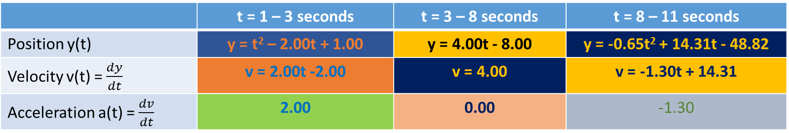
 | t = 1 – 3 seconds | t = 3 – 8 seconds | t = 8 – 11 seconds
Position y(t) | y = t² – 2.00t + 1.00 | y = 4.00t - 8.00 | y = -0.65t² + 14.31t - 48.82
Velocity v(t) = $\frac{dy}{dt}$ | v = 2.00t -2.00 | v = 4.00 | v = -1.30t + 14.31
Acceleration a(t) = $\frac{dv}{dt}$ | 2.00 | 0.00 | -1.30
Time (s) | Acceleration (m/s²)
0 | 0.00
1 | 2.00
2 | 2.00
3 | 2.00
4 | 0.00
5 | 0.00
6 | 0.00
7 | 0.00
8 | 0.00
9 | -1.30
10 | -1.30
11 | -1.30
12 | 0.00
a = 2.00
Negative acceleration
Constant velocity
Positive acceleration
a = -1.30

Slide 8
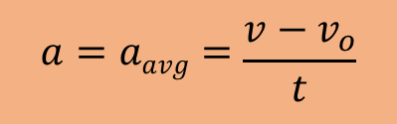
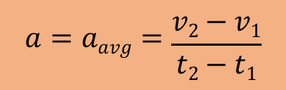
The Special Case of Uniform (Constant) Acceleration – Deriving the “BIG FIVE”
For many problems and scenarios in physics that deal with motion, if there is an acceleration, it will often be constant or uniform (such as in the elevator example).
When the acceleration is constant, the average and instantaneous accelerations will be the same such that:
$$a=aavg=\frac{v2−v1}{t2−t1}$$
We will now replace v₂ with v for the final condition and v₁ with v_{o} for the initial condition where the time t equals 0.
$$a=aavg=\frac{v−v_{o}}{t}$$

Slide 9


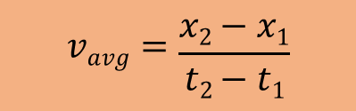


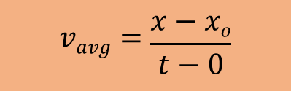
Solving for v:
$v=vo+ at$ (1)
In a similar fashion:
$$vavg=\frac{x2−x1}{t2−t1}$$
$$vavg=\frac{x−xo}{t−0}$$
Solving for x:
$x=xo+vavgt$ (2a)
And…
$vavg=\frac{1}{2}\left(vo+v\right)$ (2)
Substitute (2) into (2a) for v_{avg}, and substitute (1) into (2) for v and then solve for x
Remember… to find the average of two data points, just add them up and divide by 2…
$x−xo=vot+ \frac{1}{2}at$² (3)
You can do the algebra on your own to get this solution, or ask later…

Slide 10

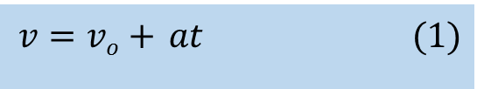
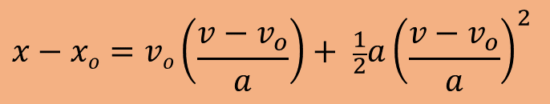


Now, let’s solve (1) for t:
$v=vo+ at$ (1)
$t=\frac{v−vo}{a}$
And then substitute it into (3) to get rid of t.
$x−xo=vot+ \frac{1}{2}at$² (3)
$$x−xo=vo\left(\frac{v−v_{o}}{a}\right)+ \frac{1}{2}a{\left(\frac{v−v_{o}}{a}\right)}^{2}$$
And using a little bit of algebra… we get…
$v2=vo2+2a(x−xo$) (4)

Slide 11



Lastly, we can solve (1) for $vo$ and substitute into (3)
$v=vo+ at$ (1)
$vo=v− at$
And then substitute it into (3) to get rid of t.
$x−xo=vot+ \frac{1}{2}at$² (3)
$x−xo=(v− at)t+ \frac{1}{2}a$t²
And using a little bit of algebra once more, we get…
$x−xo=vt− \frac{1}{2}at$² (5)

Slide 12
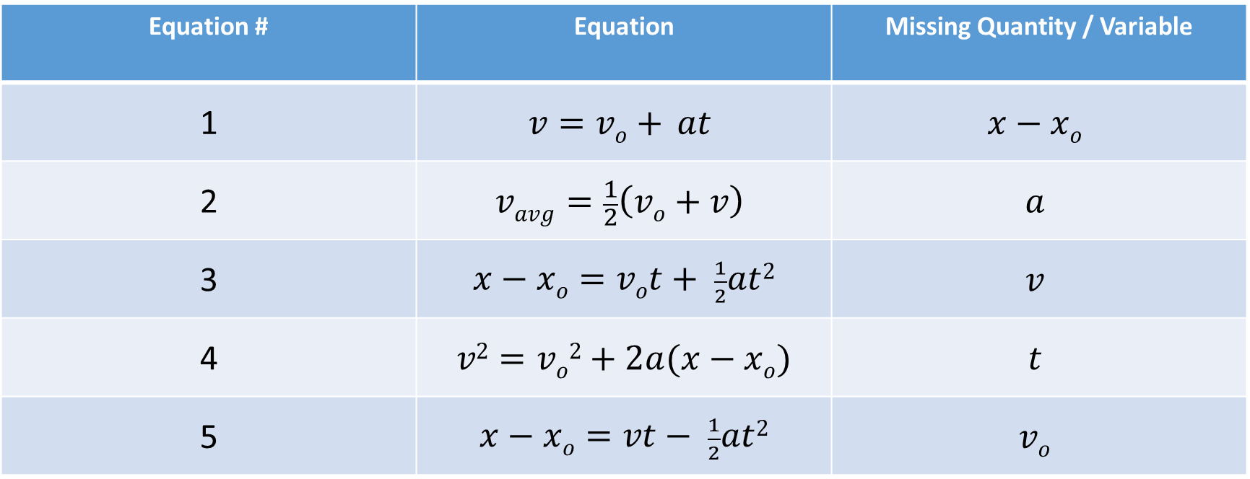
The “BIG FIVE” for Physics when the Acceleration is Constant.
Equation # | Equation | Missing Quantity / Variable
1 | $$v=vo+ at$$ | $$x−xo$$
2 | $$vavg=\frac{1}{2}\left(vo+v\right)$$ | $$a$$
3 | $x−xo=vot+ \frac{1}{2}at$² | $$v$$
4 | $v2=vo2+2a(x−xo$) | $$t$$
5 | $x−xo=vt− \frac{1}{2}at$² | $$vo$$
These equations are useful when the acceleration is constant and you are missing a particular variable.

